Slide 1
UNLOCKING THE POWER OF DATA VISUALIZATION WITH TABLEAU: Transforming Insights into Action

Slide 2
Principles of Constructing Data Visualizations
Learning Outcomes
By the end of the lesson, you will be able to:
Identify effective data visualizations and give justification.
Suggest an appropriate visualization for some data.
Evaluate a data visualization for effectiveness of communication.
Automate reporting

Slide 3
Introduction
When dealing with a significant amount of data, the idea of data visualization comes into relevance.
This is a type of visual communication that allows us to create, study and share data in a graphical manner so that the viewer can understand complex information according to its relevance and priority.
The specific learning outcomes of this session help us to integrate data visualization tools into our workflow. They also help to present our findings through engaging and interactive presentations

Slide 4

Terminology Data Visualisation - The graphical representation of information and data through the use of visual elements like charts, graphs, and maps.

Slide 5

Why Data Visualization is Important?
There are many benefits to the use of data visualization in the data presentation process. Essentially, they contribute towards the decision - making process in an organization. Below are some of the benefits:
1. Faster Action
Data visualization provides a very clear form of communication that allows organization/business leaders to interpret and act upon their information more rapidly. It means faster responses to market changes and quick identification of new opportunities which bring a competitive advantage in any industry.
2. Communicate Findings in Constructive Ways
Reports coming from data visualization tools make it possible to encapsulate complex information on operational and market conditions in a brief series or even a single graphic.

Slide 6
Why Data Visualization is Important? cont
3. Understand Connections Between Operations and Results
Data visualization allows us to track connections between operations and overall business/organization performance.
4. Embrace Emerging Trends
By using data visualization for monitoring key indicators, business/organization leaders can more easily spot market shifts and trends in varied and large data sets.
5. Create New Discussion
Data Visualization provides a ready means to tell stories from the data. Heat maps can show the development of product performance over time in multiple geographic areas, making it easier to see those that are performing very well or underperforming. This allows management to drill down into specific locations to see what's being done well or poorly.

Slide 7
What are the best practices for data visualization?
While working with different data visualization tools, we might get suggested chart types.
However, its always a good idea to develop a framework that would us to prioritize chart types for our different use cases.
This site gives us information about different types of charts and graphs
https://www.tableau.com/learn/whitepapers/which-chart-or-graph-is-right-for-you

Slide 8
Data Visualization Basics Study Materials
Data Visualization Principles: Lessons from Tufte : Data Visualization Principles: Lessons from Tufte - Moz
Data Visualization Basic Principles: https://shsulibraryguides.org/dataviz/principles
How to Design Charts and Graph: Data_Visualization_101_How_to_Design_Charts_and_Graphs.pdf (hubspot.net)

Slide 9
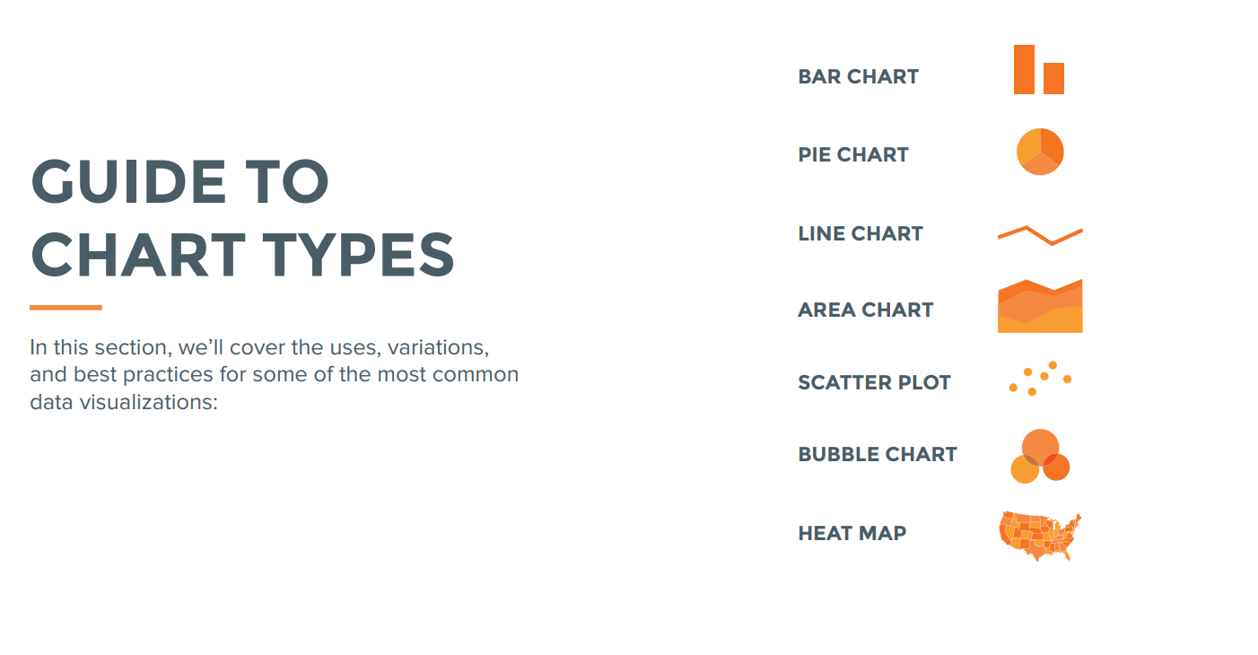

Slide 10
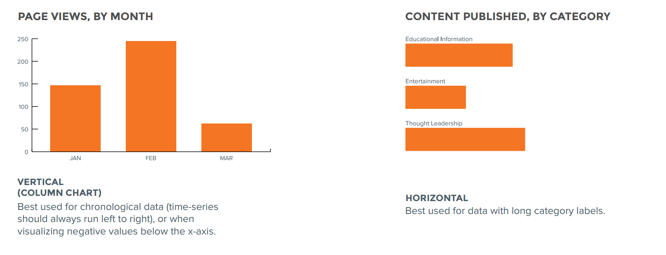
Bar Charts
Bar charts are very versatile.
They are best used to show change over time, compare different categories, or compare parts of a whole
Only product specifically dedicated to this niche market
First beautifully designed product that's both stylish and functional
Conducted testing with college students in the area
Designed with the help and input of experts in the field

Slide 11
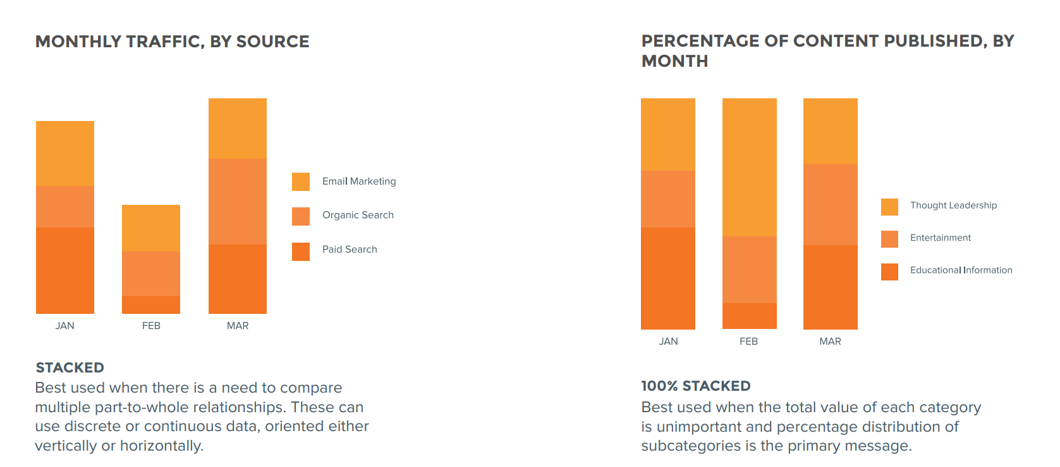
BAR CHARTS (CONT.)

Slide 12
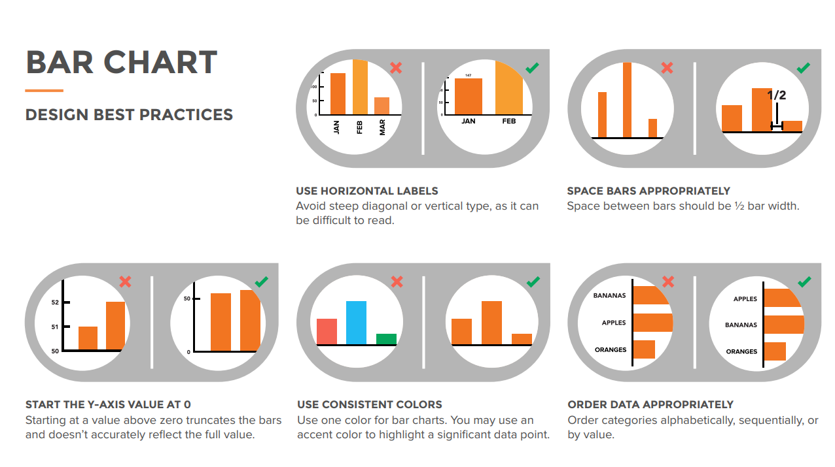

Slide 13
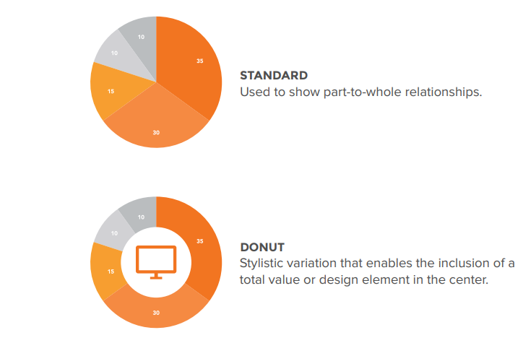
Pie Chart
The pie chart is one of the most popular chart types.
Pie charts are best used for making part-to-whole comparisons with discrete or continuous data.
They are most impactful with a small data set

Slide 14
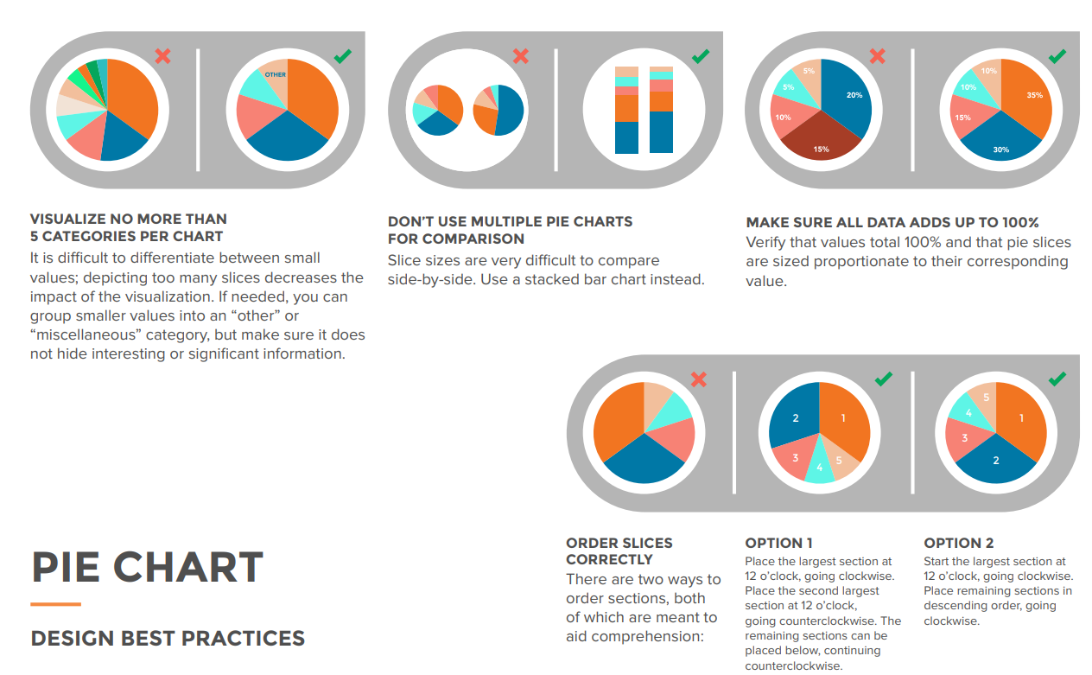

Slide 15
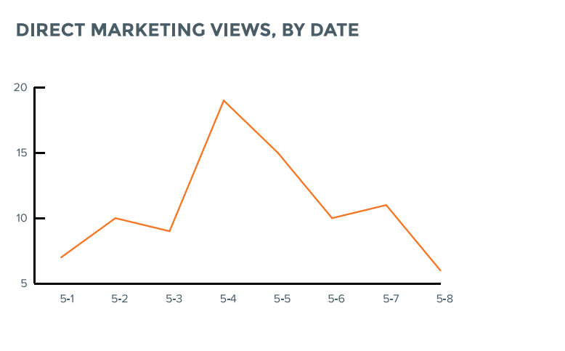
Line Chart
Line charts are used to show time-series relationships with continuous data.
They help show trend, acceleration, deceleration, and volatility.

Slide 16
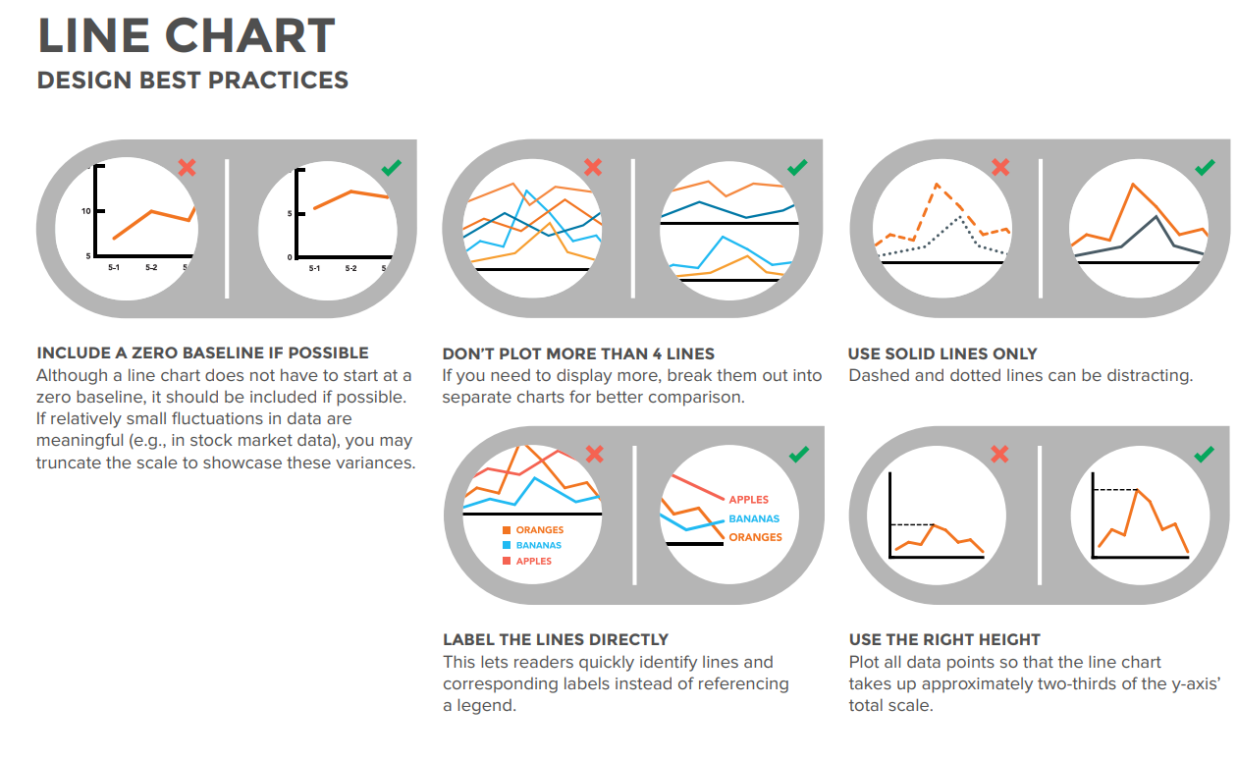

Slide 17
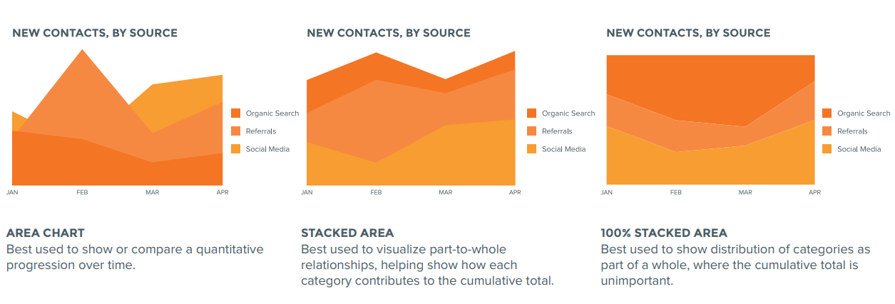
Area Chart Area charts depict a time-series relationship, but they are different than line charts in that they can represent volume.

Slide 18
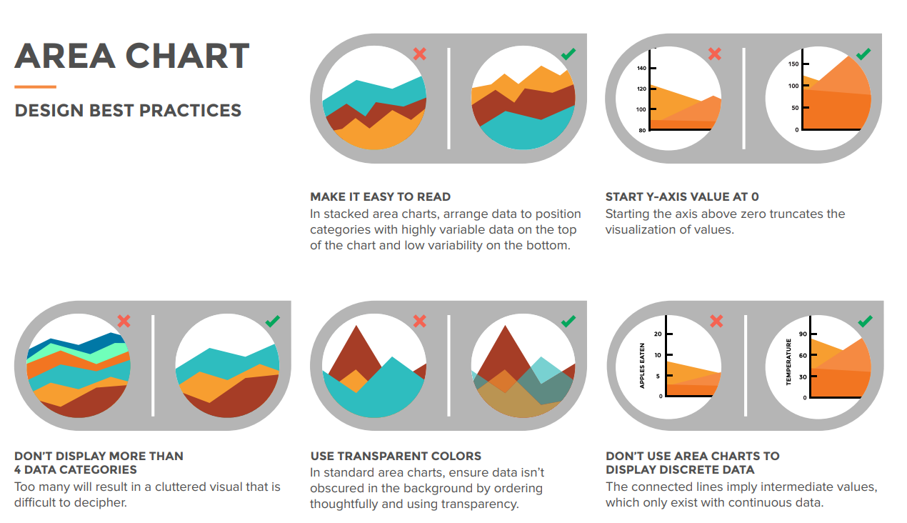

Slide 19
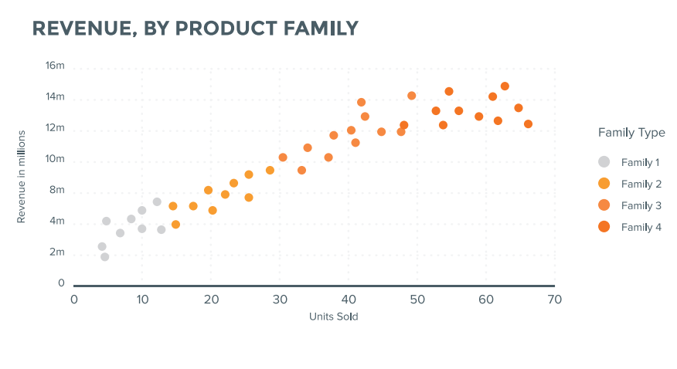
Scatter Plot Scatter plots show the relationship between items based on two sets of variables. They are best used to show correlation in a large amount of data

Slide 20
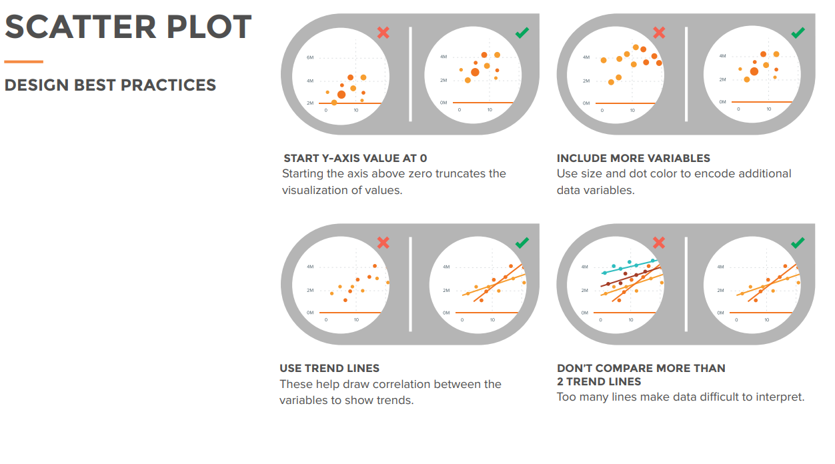

Slide 21
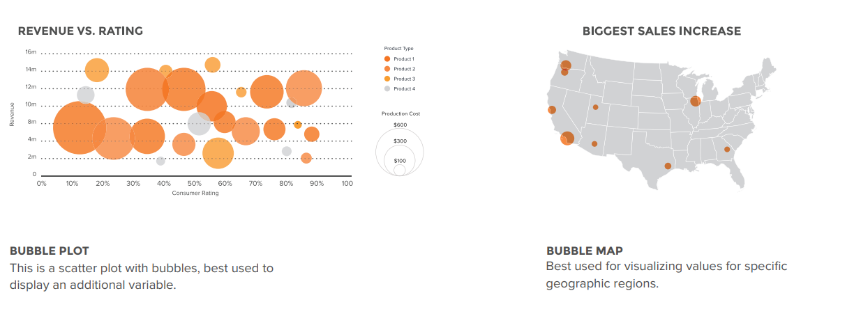
Bubble Graph Bubble charts are good for displaying nominal comparisons or ranking relationships

Slide 22
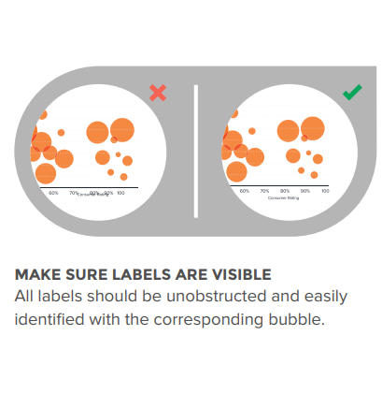
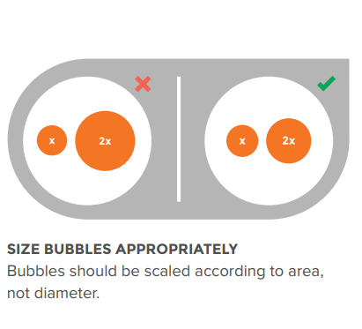
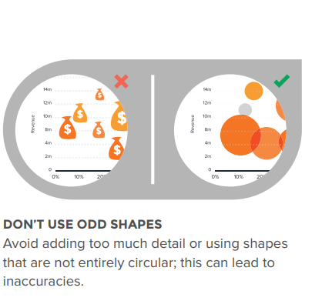
Bubble plot Design Best Practices

Slide 23
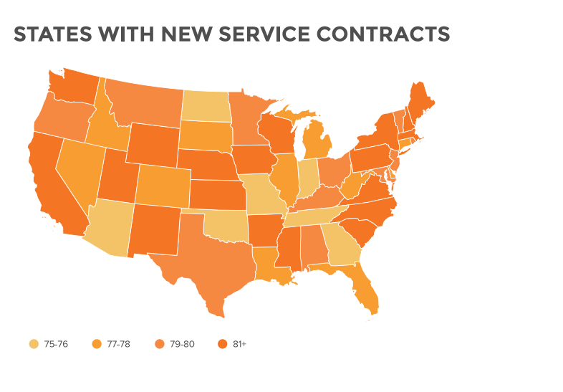
Heat Map
Heat maps display categorical data, using intensity of colour to represent values of geographic areas or data tables

Slide 24
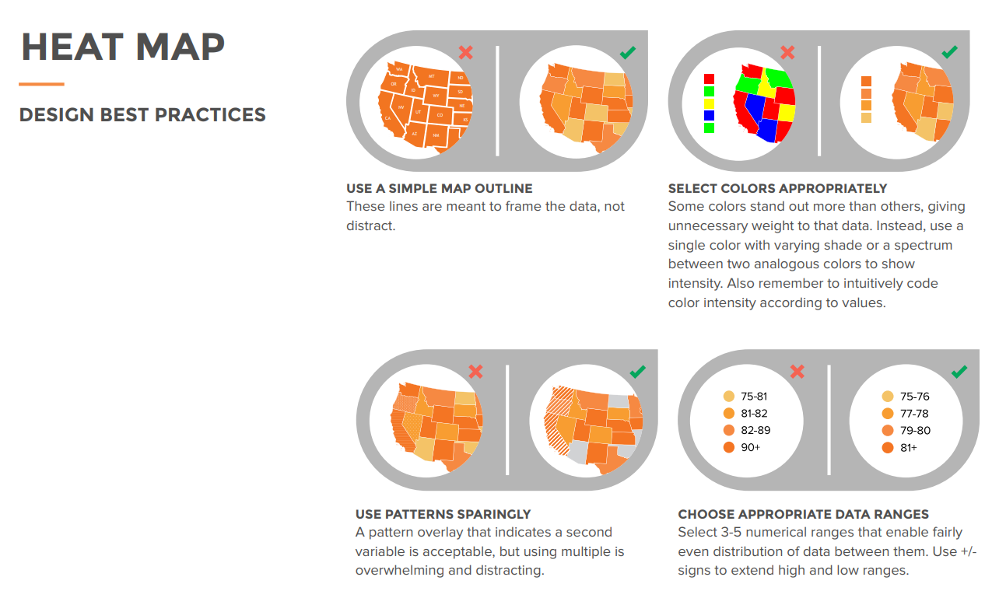

Slide 25
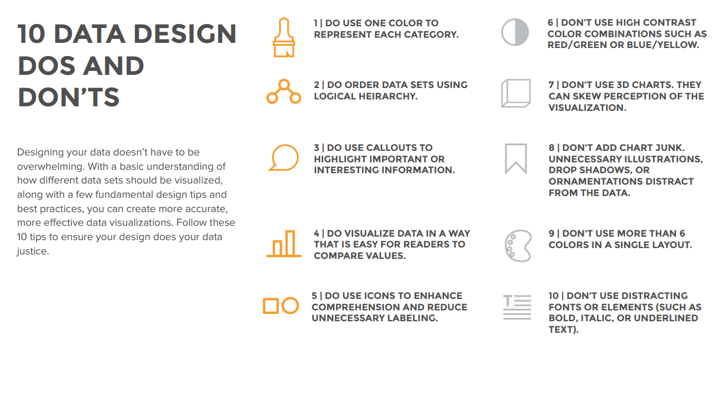

Slide 26
Thank you

